Slide 1

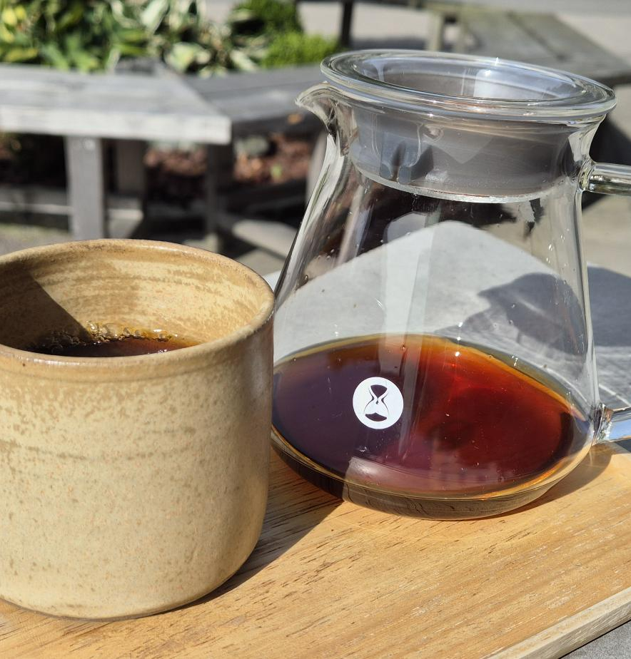




Learning How to Drink Better Coffee
Emanuel Palm Cloud Specialist, Coffee Nerd & Microsoft MVP @ Unwonted
@PalmEmanuel
Notes:
Introduction with a few comments about that it’s crazy that the organizers allowed me to do this presentation when it’s a .NET conference. “Right? Who would’ve thought they wanted a presentation on Java”

Slide 2

Notes:
It doesn’t have to be this way! At least for coffee, I can’t promise anything about the code. Especially if you decided to visit a session on Java.

Slide 3
My Coffee Journey
POWERSHELL CONFERENCE EUROPE 2023
STARTED ARKANUM
2020
2023
2026
2023
2024
ENJOYED COFFEE FOR THE FIRST TIME
SPEAKING ABOUT COFFEE AT SWETUGG STOCKHOLM
BOUGHT A COFFEE ROASTER

Slide 4
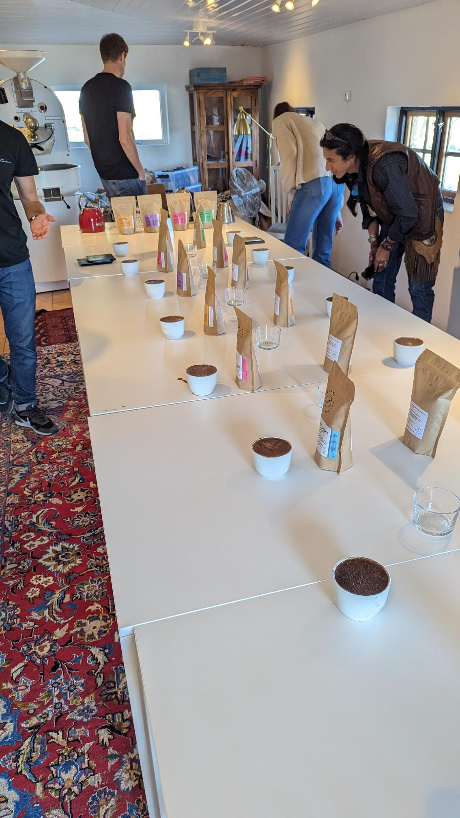
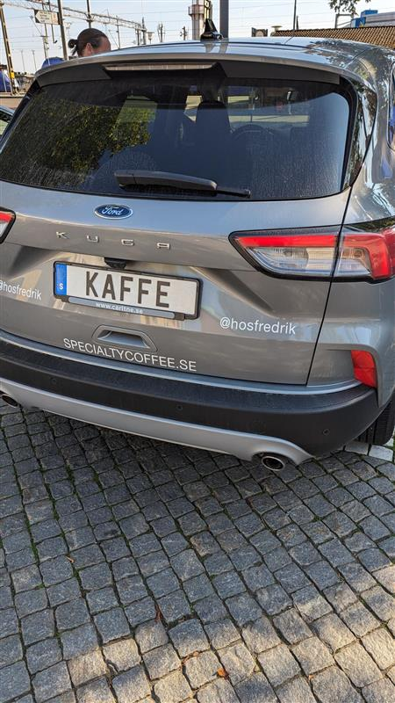
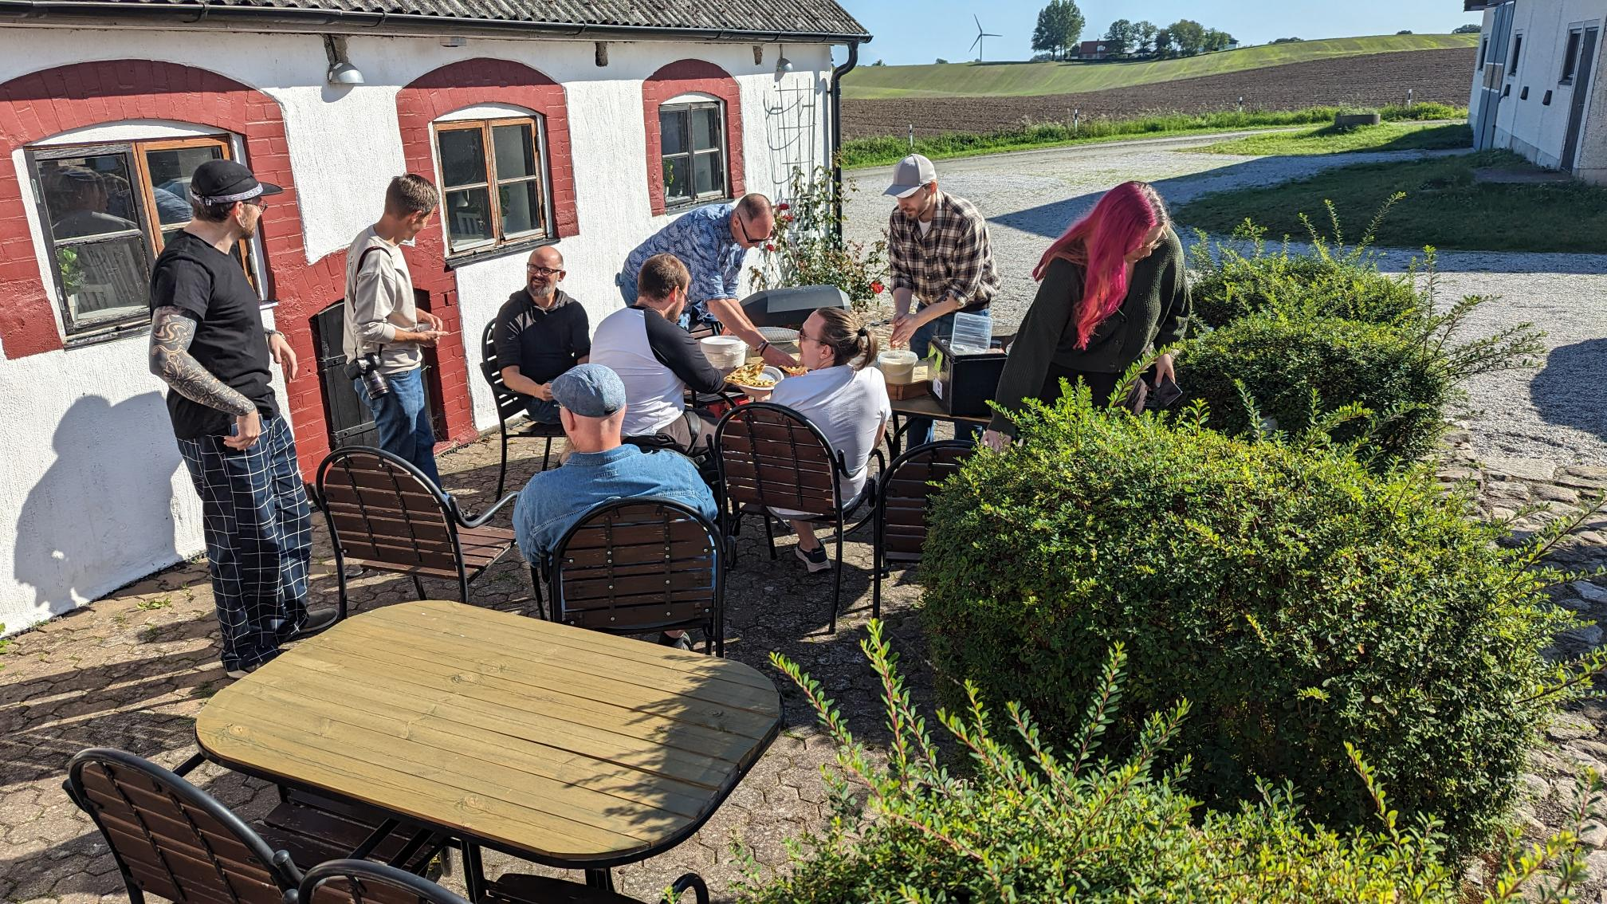
My Coffee Journey
Started drinking coffee in 2020
Story about “Red Honey” and moka pot
Rabbit hole

Slide 5
My Coffee Journey

Slide 6
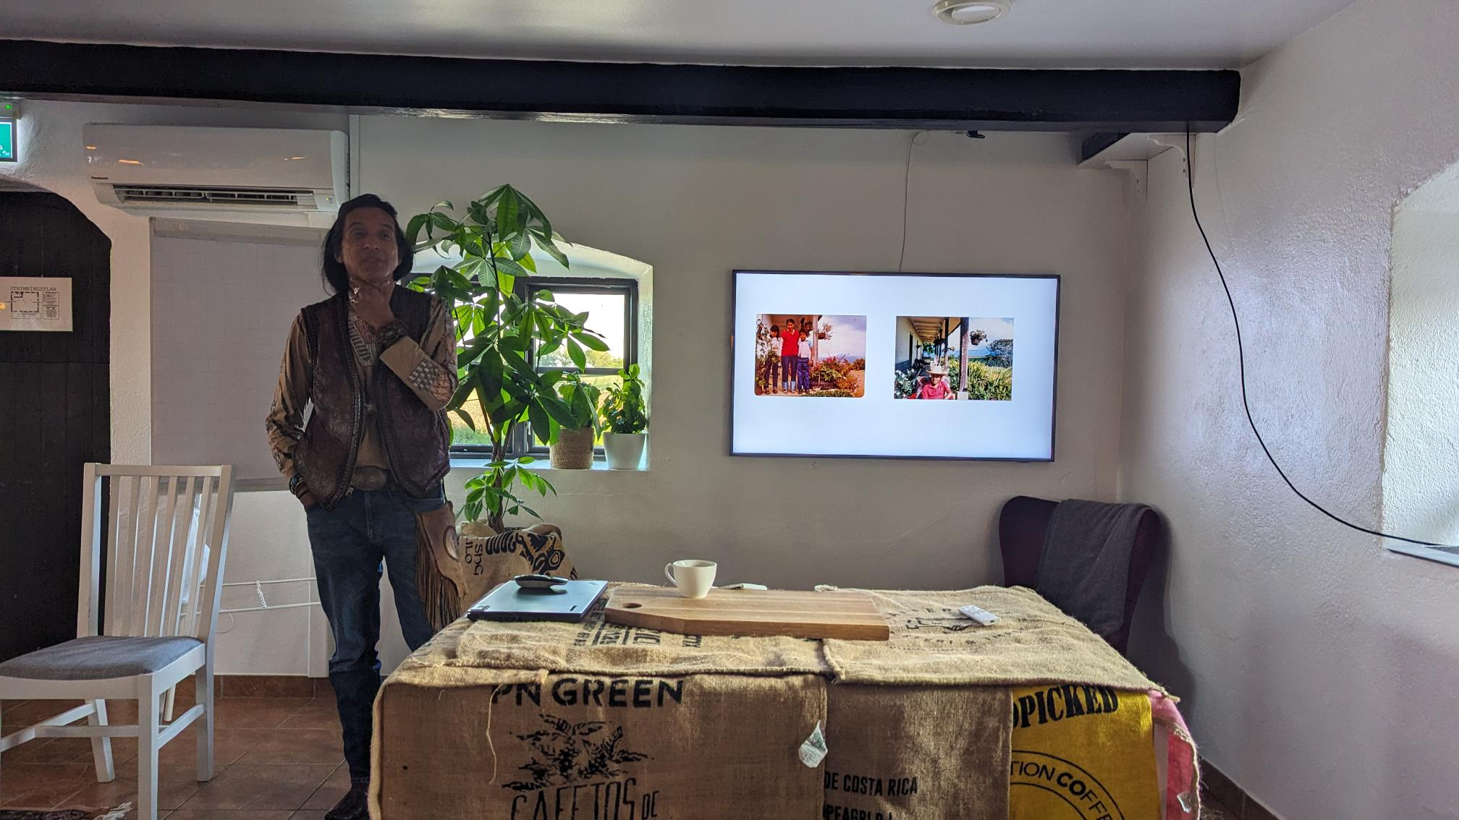
My Coffee Journey
This is Heber Sarria
He owns a farm called Finca La Tierra together with Gringo Nordic, a Coffee Roaster in Gothenburg
He talked about how it is to run a farm, the challenges of farming in Colombia where it’s hard to find people because cocaine pays more. And the dread of climate change.

Slide 7



Emanuel Palm
💙 Everything-as-Code
📦 Makes modules & tools
📃 Fan of Open Source
☁️ Blogs at pipe.how
Fun facts!
🧗 Bouldering & Climbing
🎲 Dungeons & Dragons
🥏 Disc Golf
🇸🇪
Cloud Specialist & Coffee Nerd
@PalmEmanuel

Slide 8
Emanuel Palm
☕️ Roasts coffee at arkanum.coffee
☕️ Found specialty coffee in 2020
☕️
Fun facts!
🧗 Bouldering & Climbing
🎲 Dungeons & Dragons
🥏 Disc Golf
🇸🇪
Cloud Specialist & Coffee Nerd
@PalmEmanuel

Slide 9
Agenda
What is Specialty Coffee?
From Farm to Cup
Demo – prepare with a bunch of cups close to the stage
Key Takeaways – A brew recipe
Please ask questions along the way!

Slide 10
Notes
My journey in Specialty Coffee
SSCC 2023, presentation from x about Colombia farms having a hard time finding people because cocaine pays more.
Climate change
Commodity coffee prices, how much the farmer gets
Brew recipe
Origins of coffee? Goat story?

Slide 11
Commodity vs Specialty Coffee
Price “C-price”
How do I know it’s specialty? More info and traceability is a good indicator

Slide 12
Arabica vs Robusta
Market
Varietals, development of varietals, leaf rust resilience
Coffee family tree

Slide 13
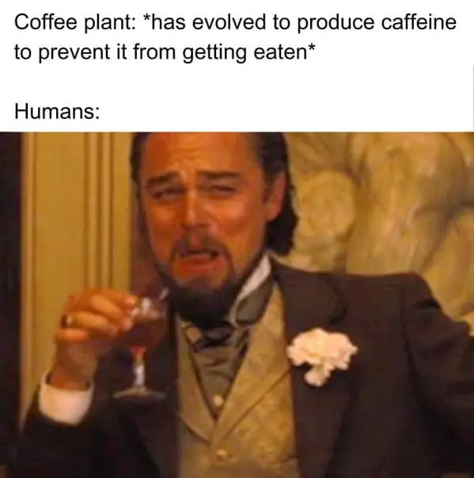
Caffeine
Caffeine is bitter
Light vs dark roast? volume vs weight in roast level
Arabica vs Robusta (robusta has more)
Caffeine comparisons? (James Hoffman video? It varies extremely widely in cafés
What about decaf?

Slide 14
Instant Coffee?
Exists in specialty coffee too, though much more rare

Slide 15
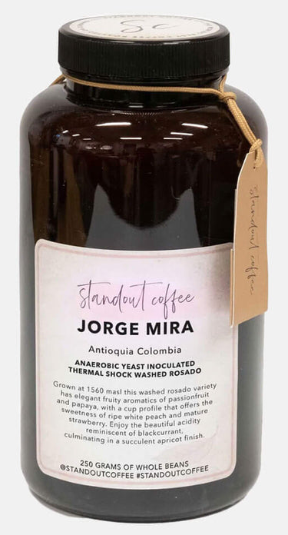
Coffee vs Wine
Flavor compounds
“Analytical chemistry studies have identified on the order of over 1,000 volatile compounds in both roasted coffee and wine. However, in both beverages only a small proportion of these compounds are present above human odor thresholds and directly contribute to perceived aroma.”
Pretentiousness - Can feel elitist but I’d like to think it often comes from a desire to accurately describe the coffee with as much traceability as possible to give justice to the farm and the process, so let’s demystify it together today
Drinking temperature, flavor perception

Slide 16
Farming – Planting, Harvesting
Coffee is a fruit
Coffee is hard to harvest with machines because they grow in mountainous terrain, rarely flat (some exceptions (find, Brazil??))

Slide 17
Processing

Slide 18
(The Market)
Show map of where coffee is grown
Harvests and prices affected by politics, conflicts, climate, supply chains

Slide 19
Roasting
Freshness from roast

Slide 20
Grinding
Freshness from grind

Slide 21
Brewing
Different brewing mechanisms and brewers, immersion, percolation, bypass
Comparison pictures of brewers
Techniques and tips, RDT
Temperature?
Over- and underextraction, acidity extracts first then bitterness

Slide 22
I just want a good cup of coffee - Variables
(pop up pictures with text one by one, pick out three in order at the end)
Beans
Process method
Varietal
Farm elevation
Roast level
Roast style / profile
Grinder
Burr types
Water
Water minerals
Filter type
Filter paper (if paper)
Pouring technique
Amount of agitation
Number of pours
Brewer
Brewing vessel
Material
Time
Dose
Ratio
Brewing temperature
Drinking temperature
Cup form (drinking)

Slide 23
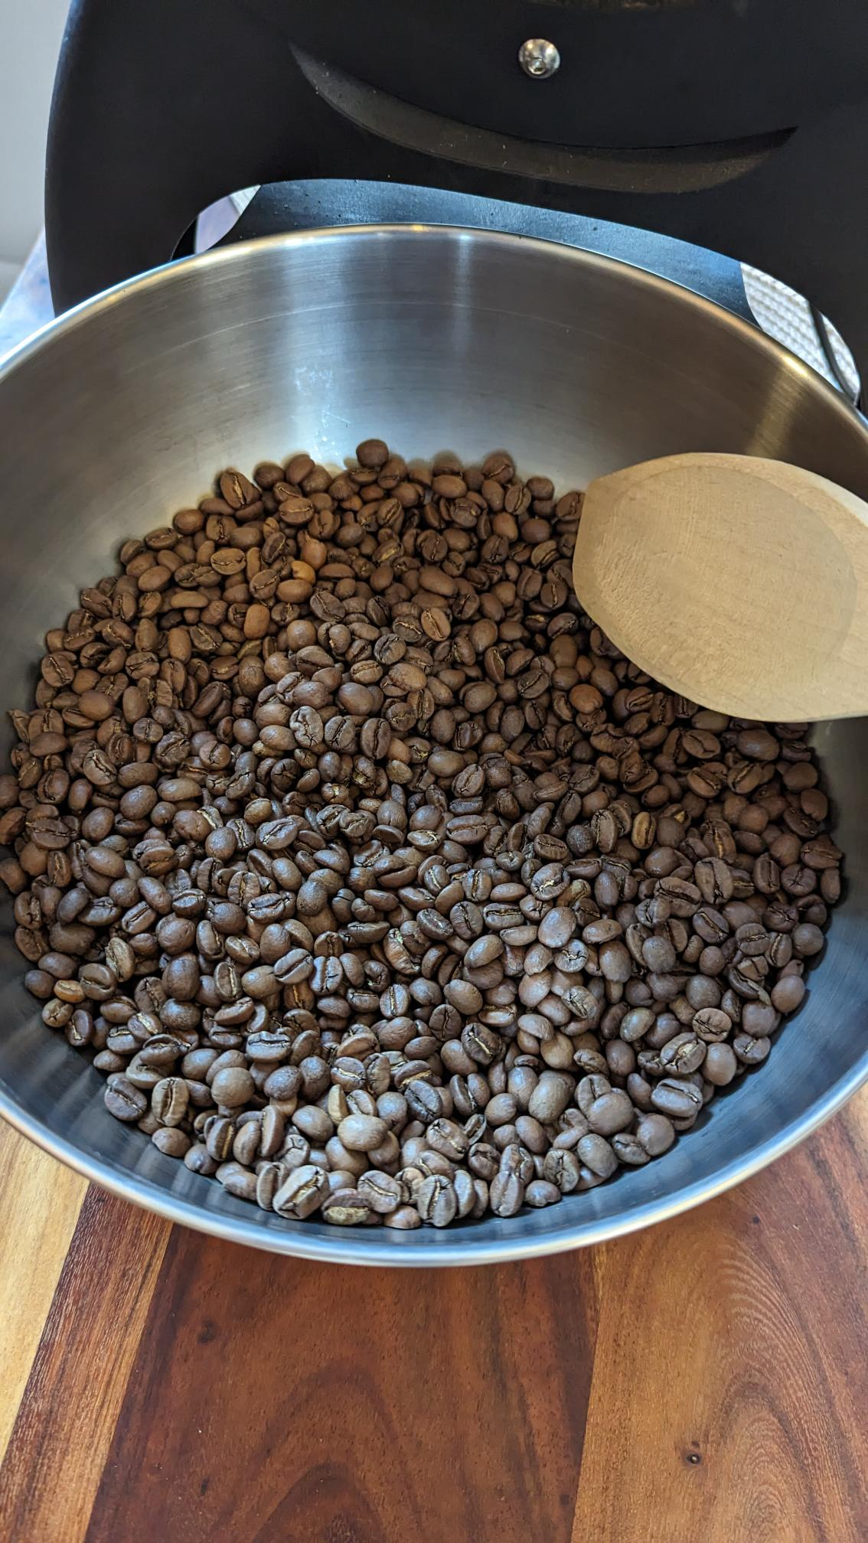
Beans
Photo: Me

Slide 24
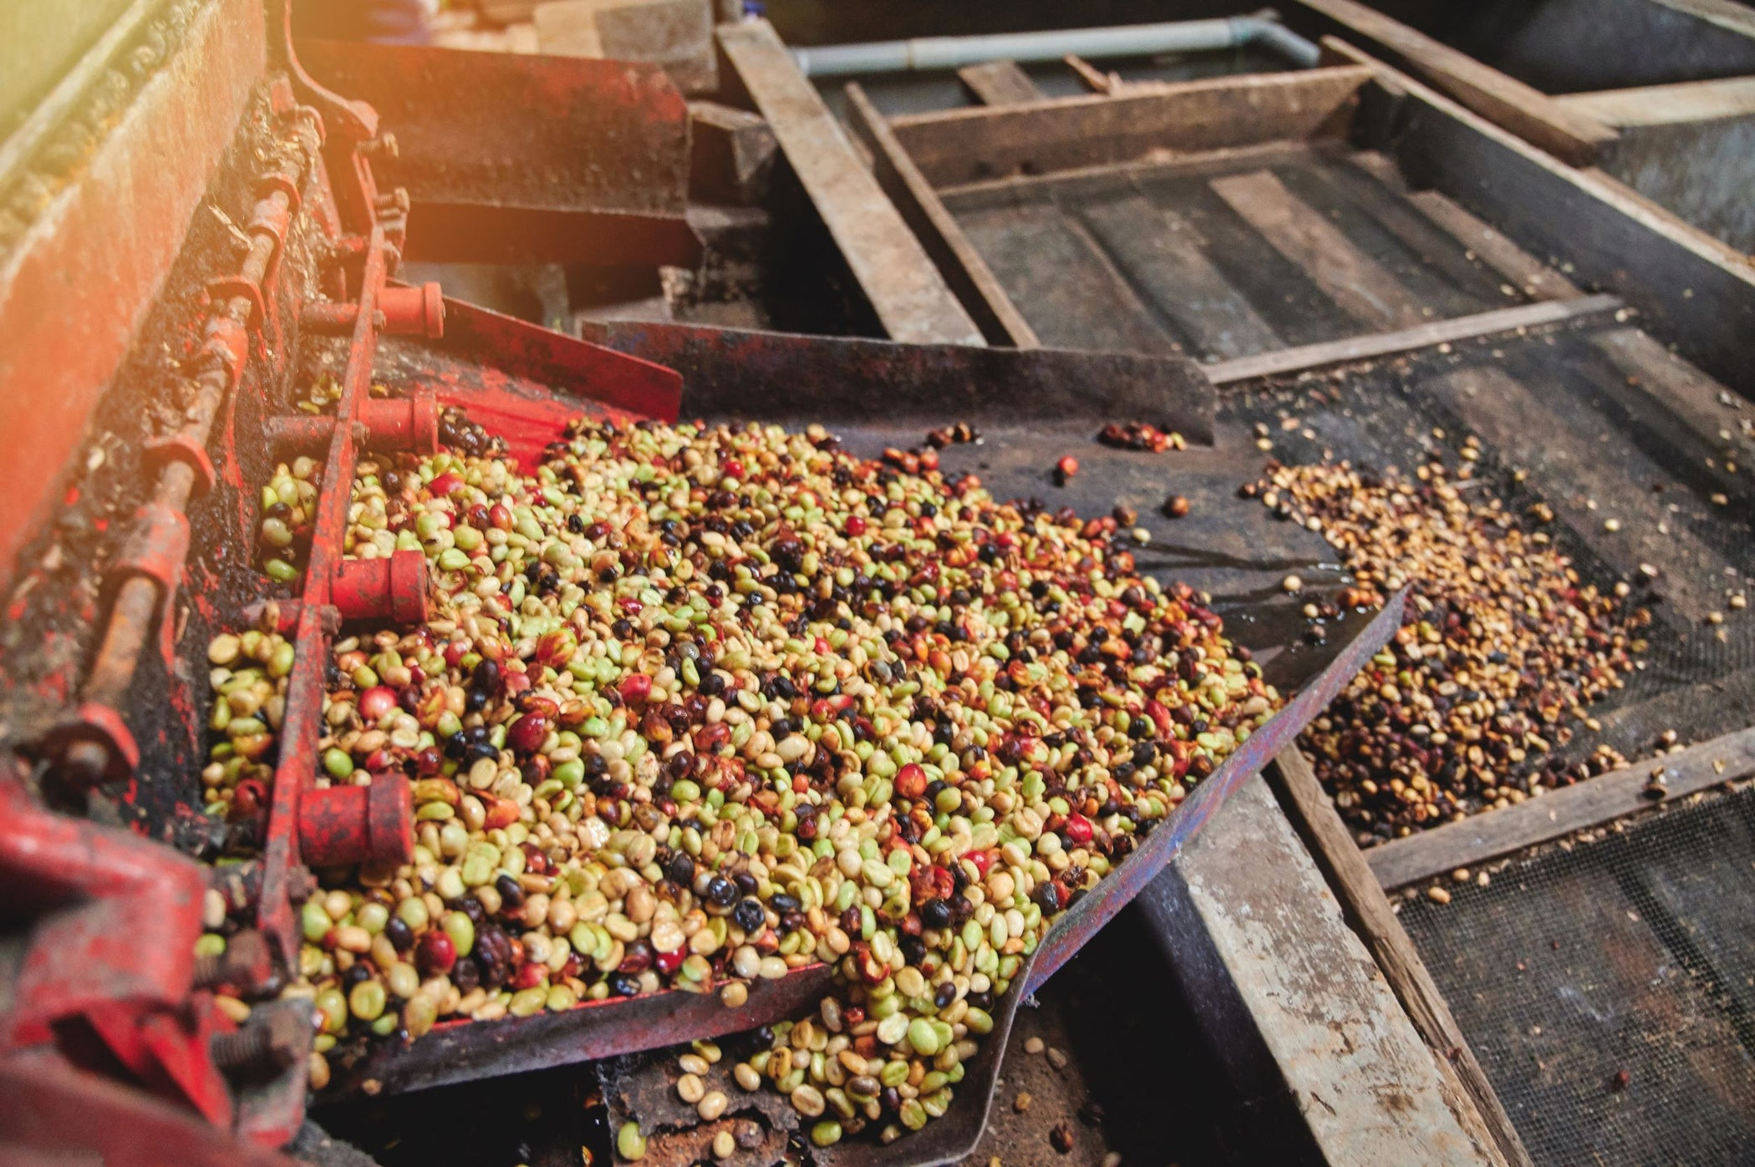
Processing Method
Photo: https://chidoricoffee.com/blogs/coffee-blog/process-method-how-coffee-gets-processed

Slide 25
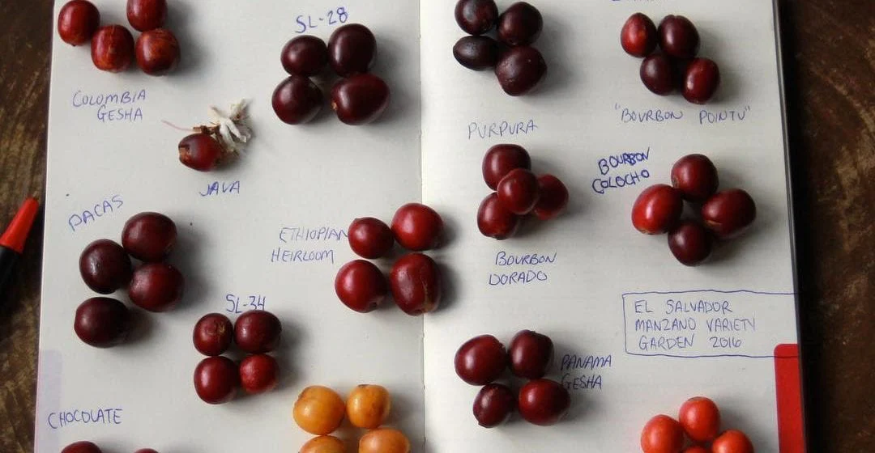
Varietal
Photo: https://farocoffee.com/blogs/news/all-about-coffee-varieties

Slide 26
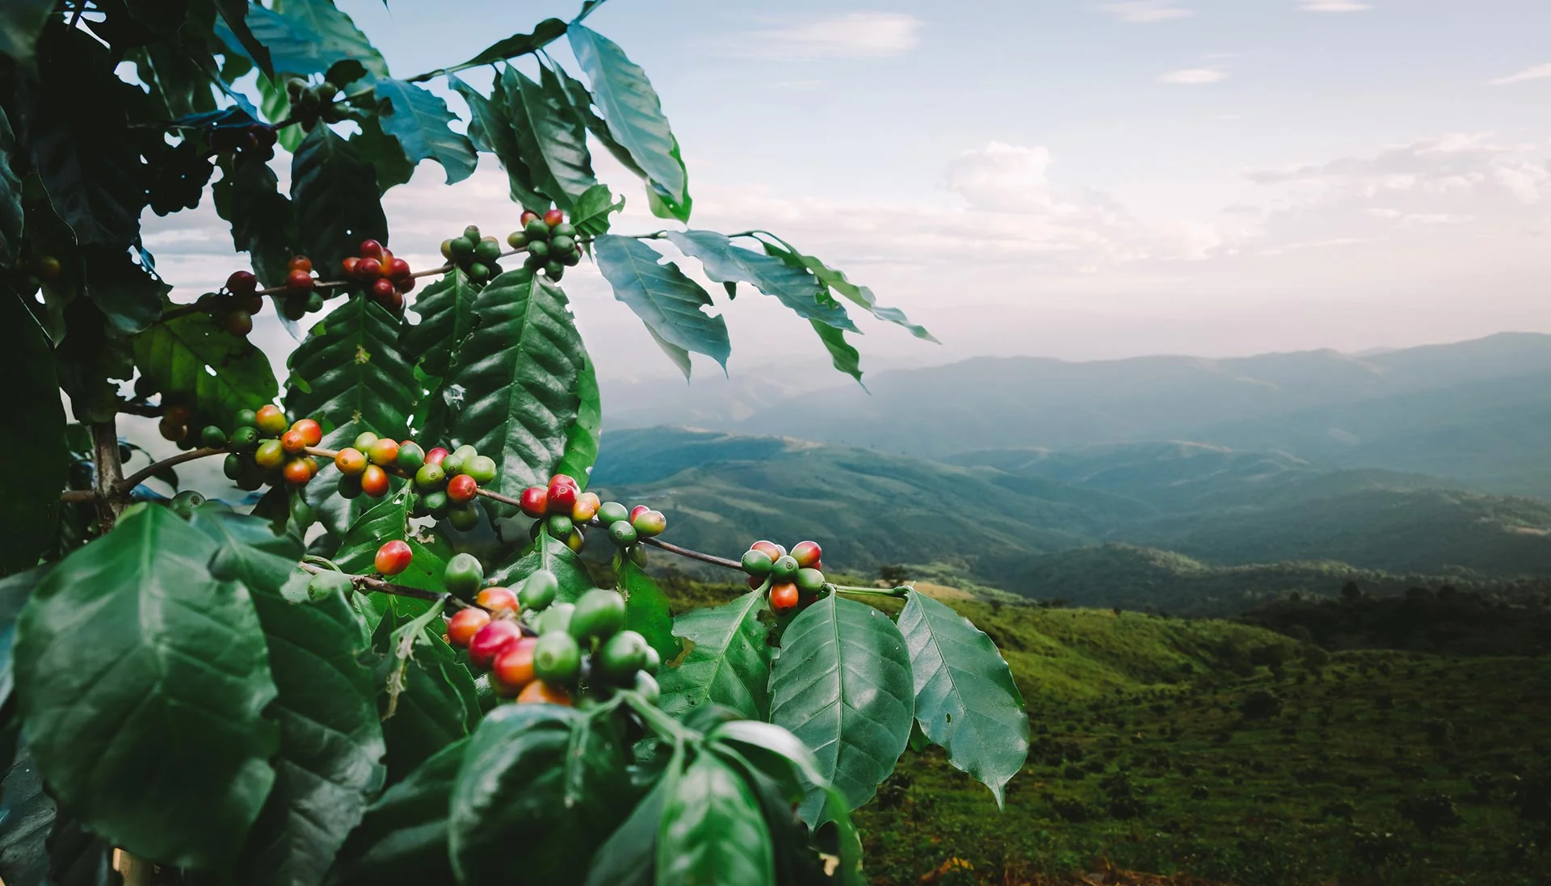
Altitude
Photo: https://kofficoffee.com/collections/single-origins

Slide 27
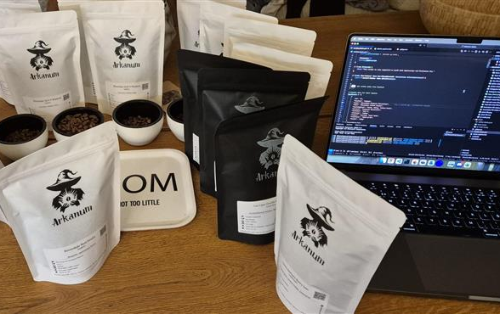
Demo Time
Example brew recipe on screen 500ml? 1L?

Slide 28
Takeaways
Is the coffee good, and is it “good” coffee? (does it have information about the country, region, farm, varietal, process, harvest period etc?)
Top 3 things to focus on
@PalmEmanuel

Slide 29
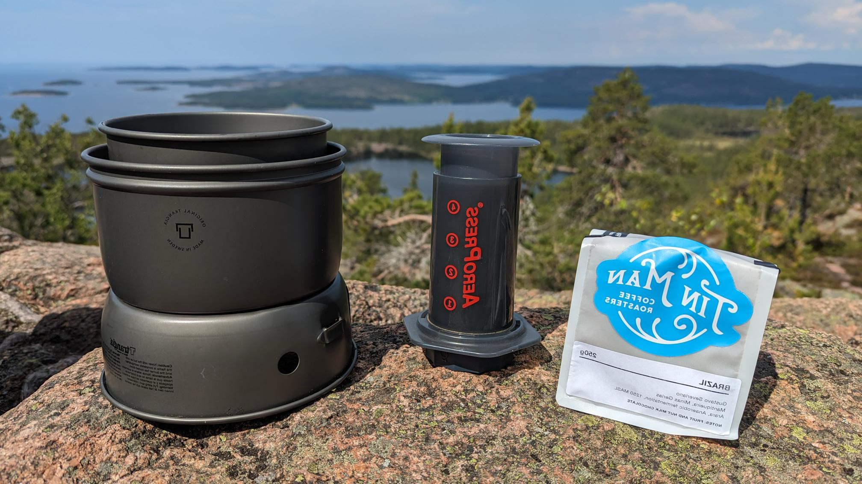
Thank you!
@PalmEmanuel

